Slide 1
Overview OF IFC Performance (PS8)
September 14th, 2022
Sofie Fleischer Michaelsen, Principal Social Development Specialist, IFC
Elena Chuzhakova, Senior Environmental Specialist, IFC
Graham Jacob, Spatial heritage consultant

Slide 2
PS8 Objectives
Protect cultural heritage from the adverse impacts of project activities and support its preservation.
Promote the equitable sharing of benefits from the use of cultural heritage.

Slide 3
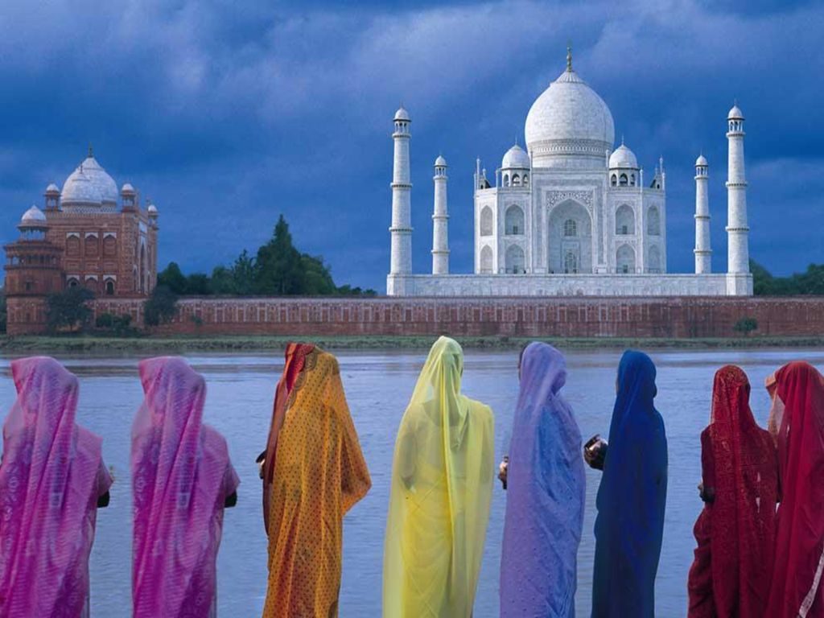
Overview of PS8: Structure of PS8
Protection of cultural heritage in project design and execution
Chance find procedure
Consultation
Community access
Removal of replicable cultural heritage
Removal of nonreplicable cultural heritage
Critical cultural heritage
Project’s use of cultural heritage

Slide 4
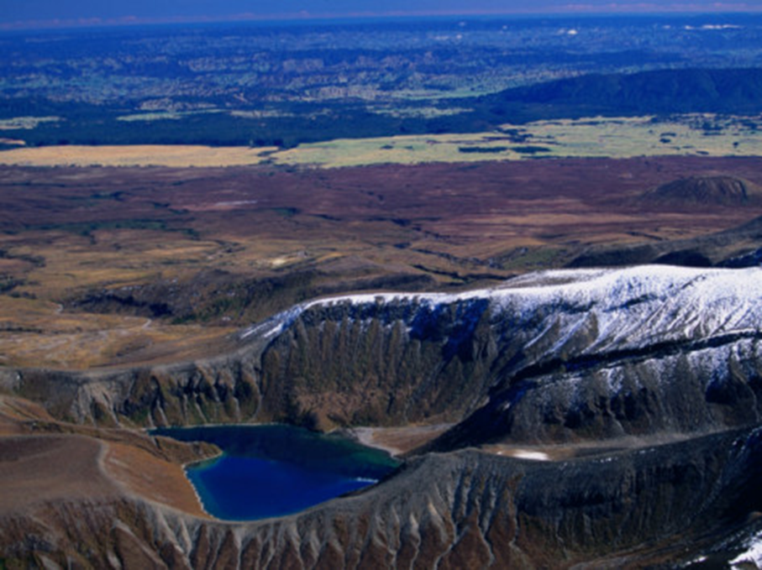
Overview of PS8—Scope of Application Cultural Heritage in Three Buckets
Unique natural features or tangible objects that embody cultural values
Tangible forms of cultural heritage
Intangible forms of culture that are proposed to be used for commercial purposes
Notes:
- Tangible forms of cultural heritage
e.g. tangible moveable or immovable objects, property, sites, structures, or groups of structures, having archaeological (prehistoric), paleontological, historical, cultural, artistic, and religious values such as Olympia in Greece/Dead Sea Scrolls.
- Unique natural features or tangible objects that embody cultural values
e.g. sacred groves, rocks, lakes, and waterfalls such as Ayres Rock (Uluru).
-Certain instances of intangible forms of culture that are proposed to be used for commercial purposes
e.g. cultural knowledge, innovations, and practices of communities embodying traditional lifestyles such as medicinal herbs or batik.
Speak to IFC early on the following issues:
Projects in UNESCO World Heritage Sites or National Parks
Other critical cultural heritage
Where non-replicable cultural heritage may be present

Slide 5
Protection of Cultural Heritage in Project Design and Execution
Examples of CH Management plans
Stakeholder Engagement Plan
Heritage inventory
Heritage statement
Alternatives Analysis
Significant Fabric Assessment
Conservation Performance Guidelines
Construction Method Statement
Adequate allocation of budget
Compliance with PS8 and applicable law
country obligation to international conventions
Assessment of the values and significance of the heritage, a process of:
Collecting available data and documentation (photo, technical documentation, legal, etc.)
Field work
Contextual analysis of the values, characteristics and significance of the CH
Determining the extend of the cultural heritage asset and its protective zones
Cultural Heritage Statement
Design of CH Conservation Strategies and Management informed by the Cultural Heritage Statement
e.g. budget informed by prioritization of heritage value
Execution and monitoring
Disclosure of key assessments/ documents and ongoing consultation with key stakeholders (regional and national)
Retain competent professionals ​ for identification and protection of CH
5
Notes:
International obligations to Convention Concerning Protection of the World Cultural and Natural Heritage
GIIP International Best practice around site surveys, excavations, preservation and publication need to be followed – need expertise on geographical area and subject matter
The requirements of PS8 apply to cultural heritage regardless of whether or not it has been legally protected or previously disturbed.
For projects with large and important components of cultural heritage: cultural heritage management plan
International expertise may be essential in addressing the removal of nonreplicable/irreplaceable cultural heritage as well as meeting requirements of critical cultural heritage (see para. 13-15).
Issues around safety (e.g. risk of structural failure) should be taken into serious consideration
Disclosure – usual would disclose long withal project documentation HOWEVER - sometimes might be prudent to not disclose information if may put the CH in jeopardy form say looters for instance.

Slide 6
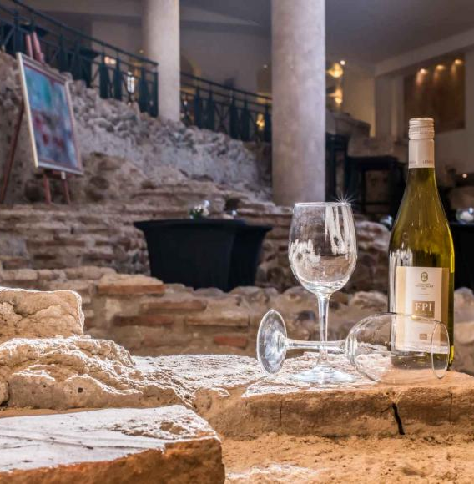
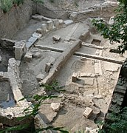
Chance Find Procedures
Client’s responsibility to avoid significant adverse impacts to cultural heritage.
Chance Finds are ‘objects of potential cultural heritage significance recovered during any site work, commonly related to archaeological sites and/or historic sites. Including surface or sub-surface artefacts.
The E&S risks and impacts identification process should determine whether the proposed project location is in areas where cultural heritage is expected to be found, either during construction or operations.
There remains the possibility for previously unknown (and as yet undiscovered) archaeological objects.
Apply the procedures when cultural heritage is subsequently discovered.
When discovered, do not disturb any chance to find until an assessment by competent professionals is made and adequate actions are identified.
6
Notes:
Professionals may need to be brought in to do an assessment and develop an Action Plan
Identifying when local expertise is appropriate and if/when international expertise needs to be brought in (paras. 7 & 14)
Consultations with local and national officials in developing chance finds procedure (para. 8)
Example of the Amphitheater of Serdica, Sofia, accidently discovered in 2004 during construction of the hotel.

Slide 7
Consultation and Community Access
Where a project may affect cultural heritage:
Consult with affected communities who use or have used within living memory the cultural heritage for longstanding cultural purposes.
Consult with Affected Communities to identify value of cultural heritage and incorporate their views in the decision-making process.
Consultation also involves relevant national and/or local competent authorities.
Where the project site contains cultural heritage used by Affected Communities, allow access to the site subject to overriding health, safety, and security considerations.
7
Notes:
Consultation should also involve:
Historical or traditional users or owners of CH
Traditional communities embodying traditional lifestyles
Ministries of Archeology, culture other heritage institutions, national or local regulatory agencies that are entrusted with protection of CH
Civil society affected communities' religious groups for whom CH is traditionally sacred
Consultation is important as not all CH is well documented or protected by law, so important part to document presence and significance assessing potential impctas and exploring mitigation options (see para 25-33 in PS1)
May need to provide alternative access routes

Slide 8
Categorization of Cultural Heritage
Replicable Cultural Heritage
Tangible forms of cultural heritage that can themselves be moved to another location or that can be replaced by a similar structure or natural features to which the cultural values can be transferred by appropriate measures.
Non-replicable Cultural Heritage
(i) cultural heritage is unique or relatively unique for the period it represents, or (ii) cultural heritage is unique or relatively unique in linking several periods in the same site.
Critical Cultural Heritage
(i) the internationally recognized heritage of communities who use, or have used within living memory the cultural heritage for long-standing cultural purposes; or (ii) legally protected cultural heritage areas, including those proposed by host governments for such designation.
8

Slide 9
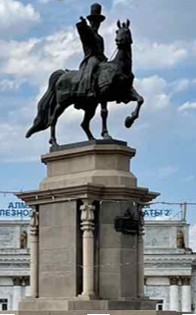
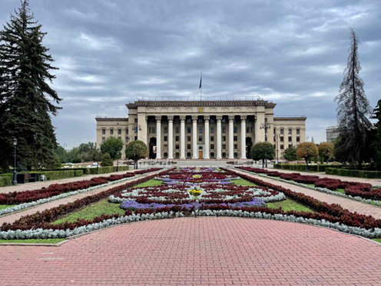
Replicable & Nonreplicable Cultural Heritage
Replicable → Apply the mitigation hierarchy
Prefer to leave in situ and maintain value and functionality.
If not possible to leave it where it is, restore its functionality elsewhere.
Removal of historical and archaeological artifacts by recognized international standards, carried out by competent professionals.
Compensation only when all else fails.
Nonreplicable → Do not remove unless all of the following three conditions are met:
There are no technically or financially feasible alternatives to removal.
The overall benefits of the project conclusively outweigh the anticipated cultural heritage loss from removal.
Any removal of cultural heritage is conducted using the best available technique.

Slide 10
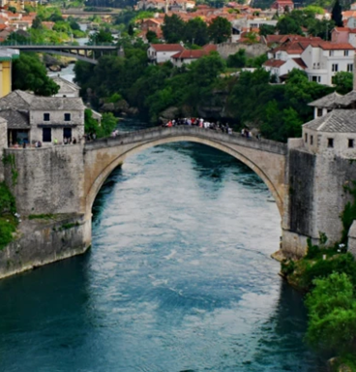
Critical Cultural Heritage
Do not remove, significantly alter, or damage critical cultural heritage.
In exceptional unavoidable circumstances, use a process of Informed Consultation and Participation (ICP) of the Affected Communities with a good faith negotiation process that results in a documented outcome. Retain external experts to assist in the assessment and protection of critical cultural heritage.
Project located in legally protected areas requires additional measures:
Comply with defined national/local regulations or the protected area management plans.
Consult the protected area sponsors and managers, local communities and other key stakeholders.
Implement additional programs to promote and enhance the conservation aims of the protected area.
Source: UNESCO
Notes:
Examples? Have we any of our own or give examples of others...
Otherwise maybe an example like - Australian Rio Tinto and Juukan Caves

Slide 11
Project’s Use of Cultural Heritage
Where a project proposes to use the cultural heritage for commercial purposes, inform communities of the following:
Their rights under national law.
The scope and nature of the proposed commercial development.
The potential consequences of such development.
Do not proceed with commercialization unless the community:
Enters into a process of ICP as described in PS1 and which uses a good faith negotiation process that results in a documented outcome.
Provides for fair and equitable sharing of benefits from commercialization of such knowledge, innovation, or practice, consistent with their customs and traditions.
Notes:
cultural heritage (e.g. knowledge, innovations, or practices of local communities) such as medicinal crops being used for modern medicine/drugs or batik making

Slide 12
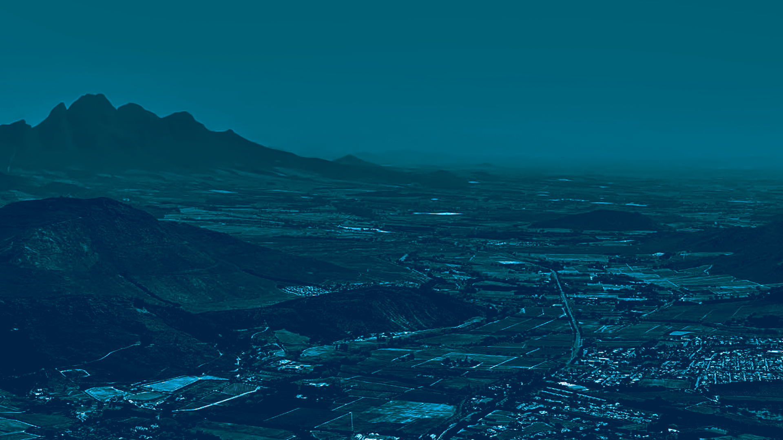
Overview OF IFC Performance (PS8)
Q&A
Notes:
Consultation should also involve:
Historical or traditional users or owners of CH
Traditional communities embodying traditional lifestyles
Ministries of Archeology, culture other heritage institutions, national or local regulatory agencies that are entrusted with protection of CH
Civil society affected communities' religious groups for whom CH is traditionally sacred
Consultation is important as not all CH is well documented or protected by law, so important part to document presence and significance assessing potential impctas and exploring mitigation options (see para 25-33 in PS1)
May need to provide alternative access routes

Slide 13
Defining Cultural/Heritage Significance
In terms of the ICOMOS Burra Charter, cultural significance means:
Aesthetic: with architectural, artistic, scenic or other visual attributes
Historic: associated with past events, eras, groups or personalities/individuals
Scientific: associated with archaeological and paleontological material, inventions, innovations and related analytical processes of a physical or natural nature
Social: of significance to a particular community for reasons relating to human interaction, whether historical or contemporary.
or
Spiritual: relating to people’s thoughts and belief systems
Notes:
Examples? Have we any of our own or give examples of others...
Otherwise maybe an example like - Australian Rio Tinto and Juukan Caves

Slide 14
Degrees of Cultural/Heritage Significance
Is the heritage resource of international, national, regional or local significance?
This to be understood in order to:
Enable scarce skills to be focused on areas of greatest heritage need;
Inform spatial management and help identify heritage management allocations;
Assist in the identification of heritage/conservation or related special protection areas;
Assist in the preparation of heritage management plans;
Inform local planning policy, spatial development frameworks etc. and
Prioritize heritage projects in the face of limited funding.
Notes:
Examples? Have we any of our own or give examples of others...
Otherwise maybe an example like - Australian Rio Tinto and Juukan Caves

Slide 15
Cultural Landscapes: from the Tangible to Intangible
Landscapes designed and created intentionally by ‘man’ (i.e. landscapes most deliberately modified and shaped by people);
Organically ‘evolved’ landscapes (i.e. shaped by the combined energies of people and nature); and
Associative cultural landscapes (i.e. least evidently ‘shaped’ by people but religiously, artistically or socially valued in terms of the natural element).
Notes:
Examples? Have we any of our own or give examples of others...
Otherwise maybe an example like - Australian Rio Tinto and Juukan Caves

Slide 16
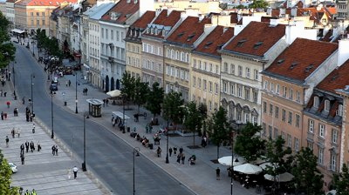
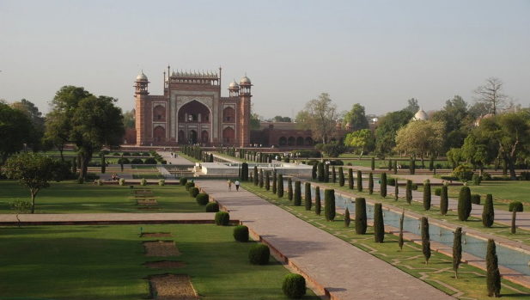
Cultural Landscape Category 1
Warsaw Old Town, Poland
Taj Mahal gardens, Agra, India
Landscapes designed and created intentionally by ‘man’ (i.e. landscapes most deliberately modified and shaped by people)
Notes:
Examples? Have we any of our own or give examples of others...
Otherwise maybe an example like - Australian Rio Tinto and Juukan Caves

Slide 17
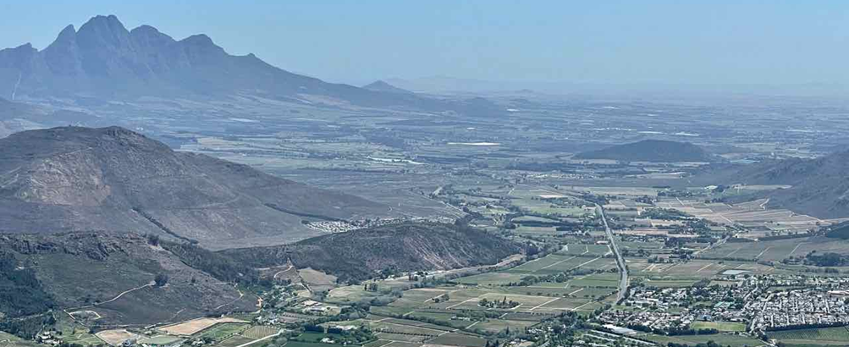
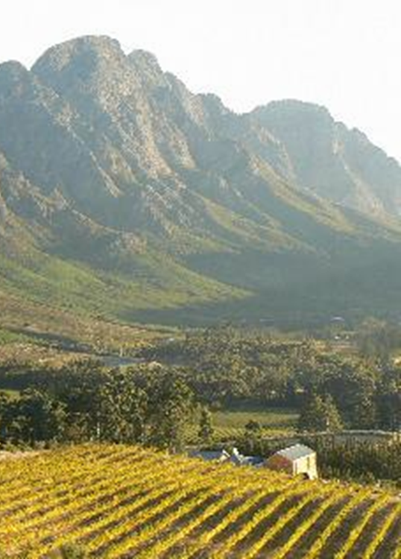
Cultural Landscape Category 2
Graham Jacobs
Cape Winelands, Franschhoek, South Africa
Organically evolved landscapes (i.e. shaped by the combined energies of people and nature)
Notes:
Examples? Have we any of our own or give examples of others...
Otherwise maybe an example like - Australian Rio Tinto and Juukan Caves

Slide 18
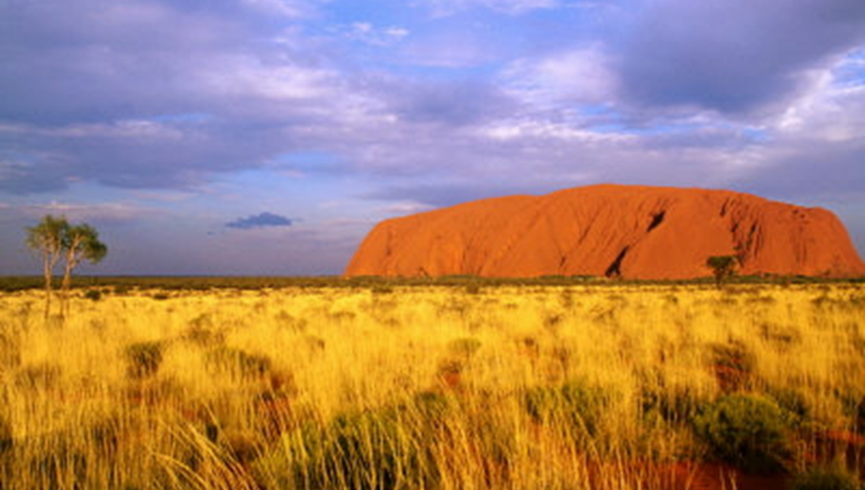
Cultural Landscape Category 3
Tongariro National Park, New Zealand (newzealand.com)
Uluru-Kata Tjuta National Park, Australia (gettyimages.com)
Associative cultural landscapes (i.e. least evidently shaped by people but religiously, artistically or socially valued in terms of the natural element)
Notes:
Examples? Have we any of our own or give examples of others...
Otherwise maybe an example like - Australian Rio Tinto and Juukan Caves

Slide 19
Significance of the Built Environment: Case Study
Graham Jacobs
Alma Ata Soviet era railway station, Almaty, Kazakhstan
Graham Jacobs
Notes:
Examples? Have we any of our own or give examples of others...
Otherwise maybe an example like - Australian Rio Tinto and Juukan Caves

Slide 20
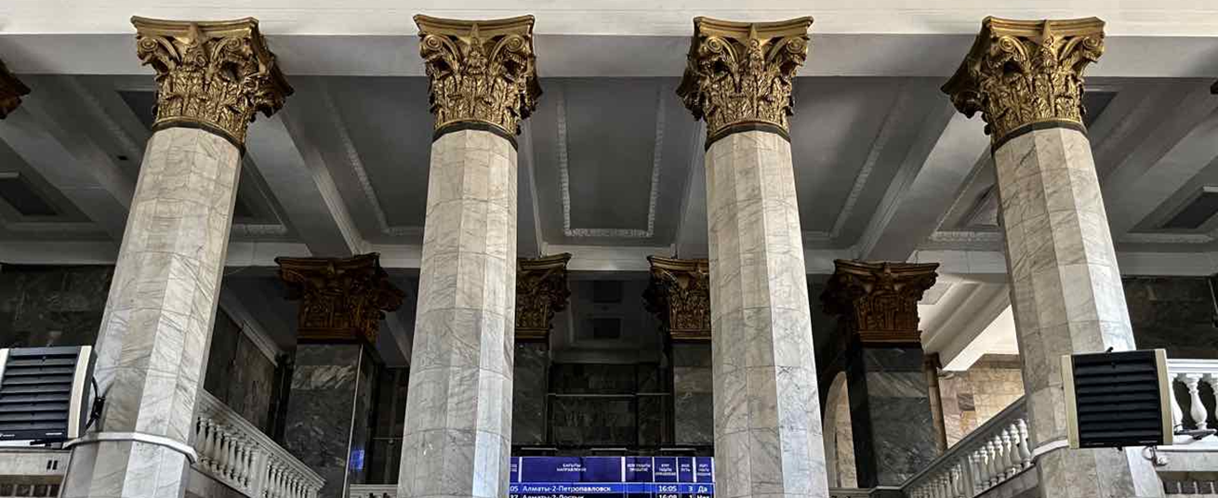
Significance of the Built Environment: Case Study
Graham Jacobs
Alma Ata Soviet era railway station, Almaty, Kazakhstan
Graham Jacobs
Notes:
Examples? Have we any of our own or give examples of others...
Otherwise maybe an example like - Australian Rio Tinto and Juukan Caves

Slide 21
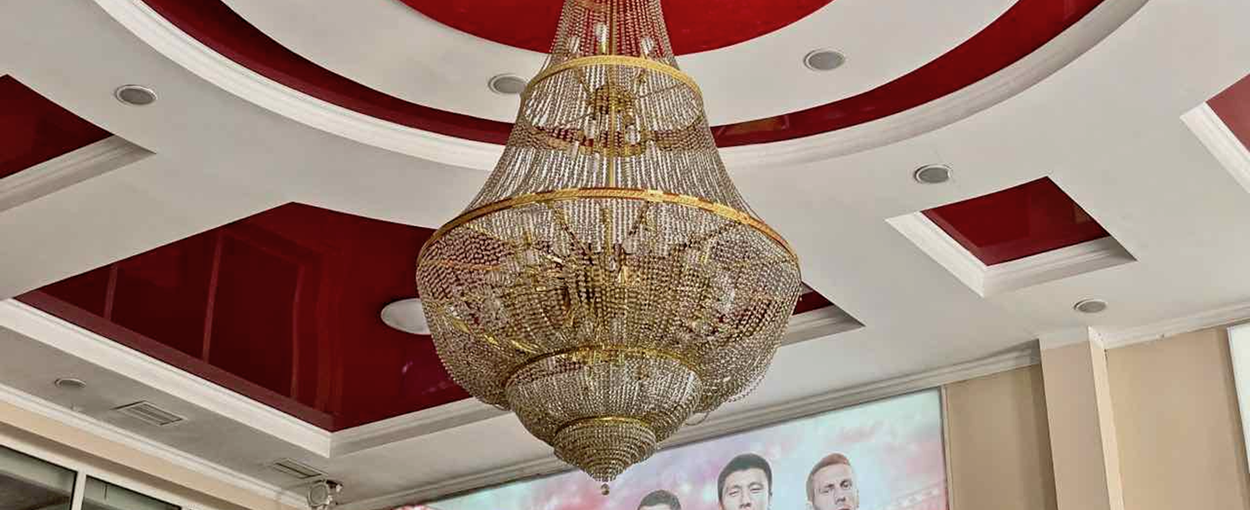
Significance of the Built Environment: Case Study
Graham Jacobs
Alma Ata Soviet era railway station, Almaty, Kazakhstan
Graham Jacobs
Notes:
Examples? Have we any of our own or give examples of others...
Otherwise maybe an example like - Australian Rio Tinto and Juukan Caves

Slide 22
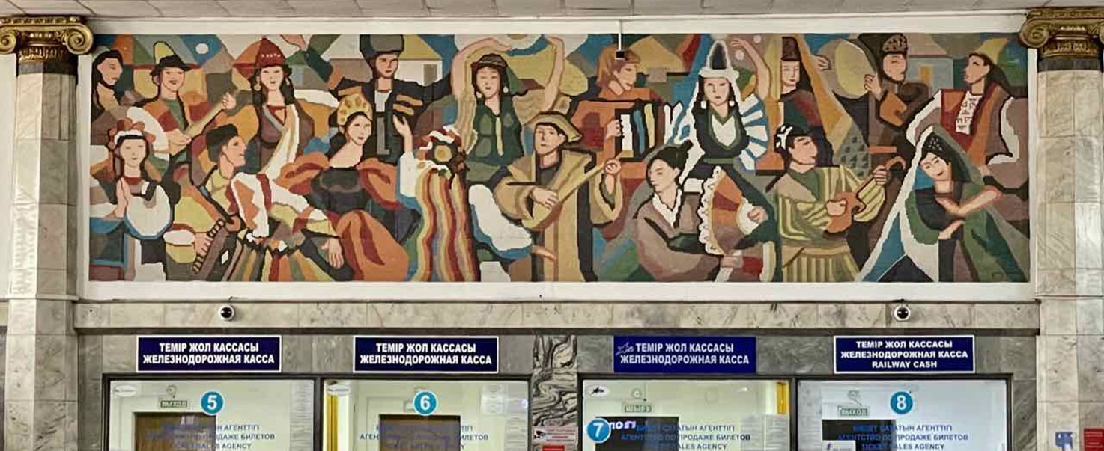
Significance of the Built Environment: Case Study
Graham Jacobs
Alma Ata Soviet era railway station, Almaty, Kazakhstan
Graham Jacobs
Notes:
Examples? Have we any of our own or give examples of others...
Otherwise maybe an example like - Australian Rio Tinto and Juukan Caves

Slide 23
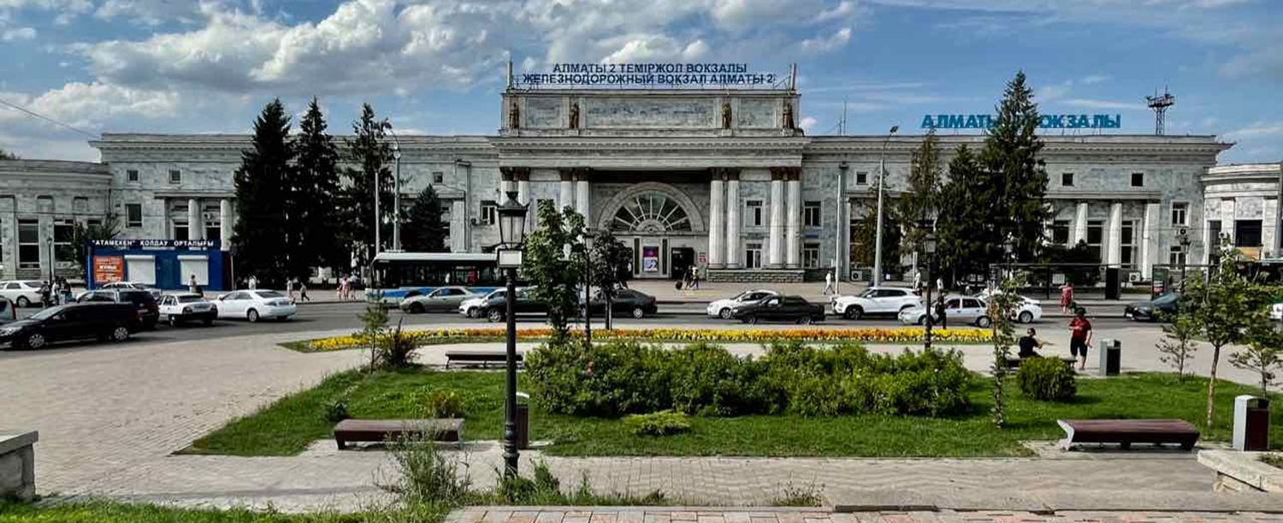
Significance of the Built Environment: Case Study
Graham Jacobs
Alma Ata Soviet era railway station, Almaty, Kazakhstan
Graham Jacobs
Notes:
Examples? Have we any of our own or give examples of others...
Otherwise maybe an example like - Australian Rio Tinto and Juukan Caves

Slide 24
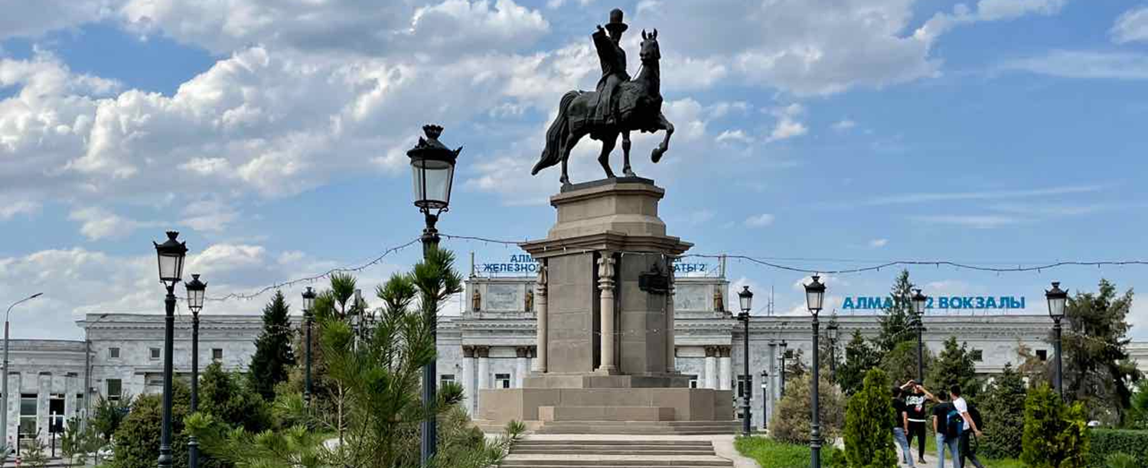
Significance of the Built Environment: Case Study
Graham Jacobs
Alma Ata Soviet era railway station, Almaty, Kazakhstan
Graham Jacobs
Notes:
Examples? Have we any of our own or give examples of others...
Otherwise maybe an example like - Australian Rio Tinto and Juukan Caves

Slide 25
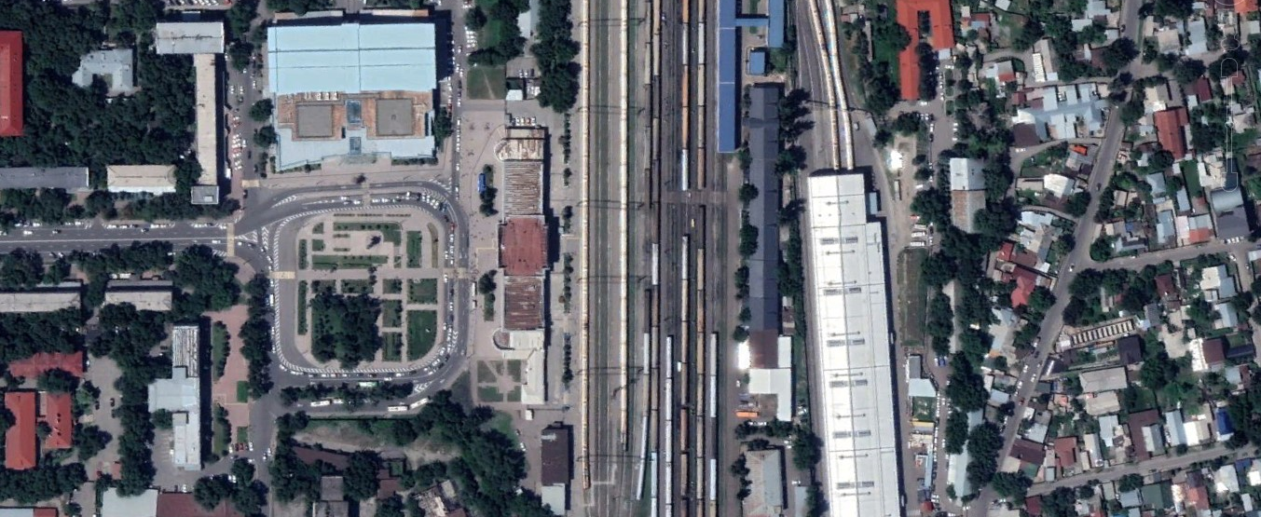
Significance of the Built Environment: Case Study
statue
Alma Ata
axis
railway station
Old Soviet era railway station, Almaty, Kazakhstan: city context
Google Earth
Graham Jacobs
Notes:
Examples? Have we any of our own or give examples of others...
Otherwise maybe an example like - Australian Rio Tinto and Juukan Caves

Slide 26
Significance of the Built Environment: Case Study
(All images: Graham Jacobs)
Abylai Khan Ave
Alma Ata railway station
national
library
railway
station
Old Soviet era railway station, Almaty, Kazakhstan: city context
Old Soviet era railway station, Almaty, Kazakhstan: city context
National Library
Google Earth
Graham Jacobs
Google Earth
Notes:
Examples? Have we any of our own or give examples of others...
Otherwise maybe an example like - Australian Rio Tinto and Juukan Caves

Slide 27
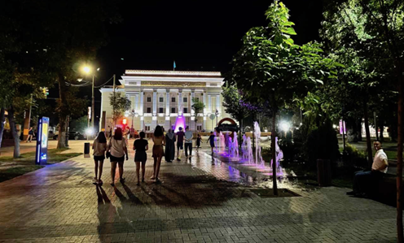
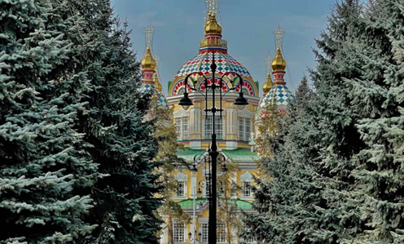
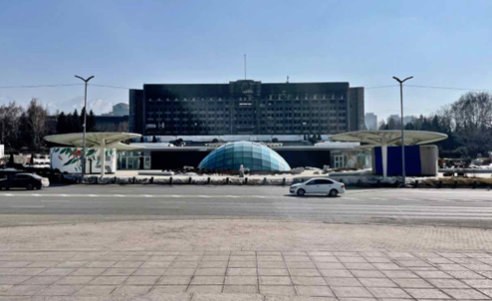
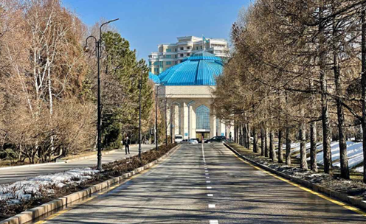
Significance of the Built Environment: Case Study
(All images: Graham Jacobs)
Kazakstan American Free University
National Opera House
St Nicholas Cathedral
Old Soviet era railway station, Almaty: similar axial occurrences
National museum of the Republic of Kazakhstan
The Akimat building
Notes:
Examples? Have we any of our own or give examples of others...
Otherwise maybe an example like - Australian Rio Tinto and Juukan Caves

Slide 28
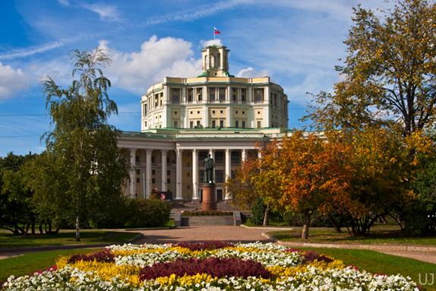
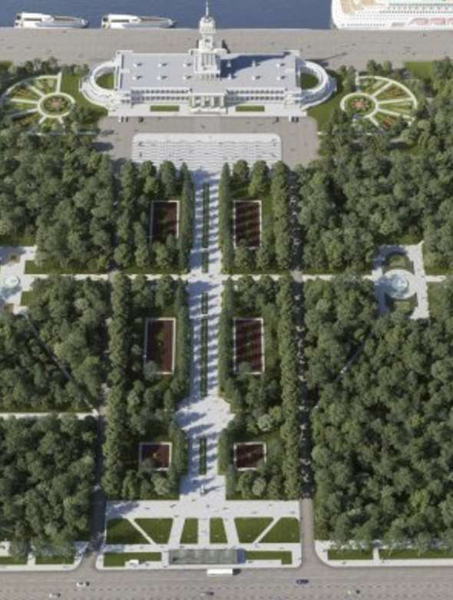
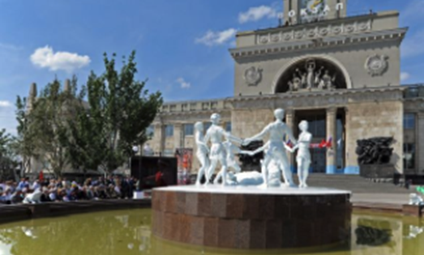
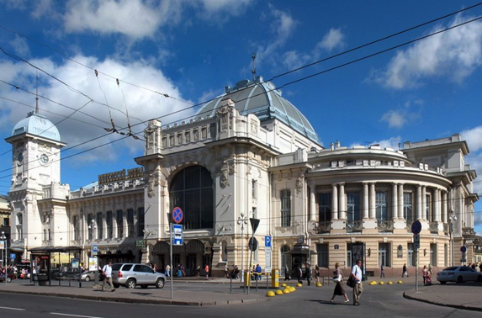
Significance of the Built Environment: Case Study
Russian Army Theatre, Moscow (1929) (Unclejosef)
Volgograd Railway Station (1951-1954) (The Moscow Times)
Old Soviet era railway station, Almaty: related Russian cases
North River Terminal, Moscow (1937)
Vitebsky Railway Station, St Petersburg (1904) (inyourpocket.com)
Notes:
Examples? Have we any of our own or give examples of others...
Otherwise maybe an example like - Australian Rio Tinto and Juukan Caves

Slide 29
Overview OF IFC Performance (PS8)
Q&A
Notes:
Consultation should also involve:
Historical or traditional users or owners of CH
Traditional communities embodying traditional lifestyles
Ministries of Archeology, culture other heritage institutions, national or local regulatory agencies that are entrusted with protection of CH
Civil society affected communities' religious groups for whom CH is traditionally sacred
Consultation is important as not all CH is well documented or protected by law, so important part to document presence and significance assessing potential impctas and exploring mitigation options (see para 25-33 in PS1)
May need to provide alternative access routes

Slide 30
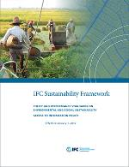
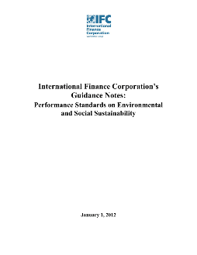
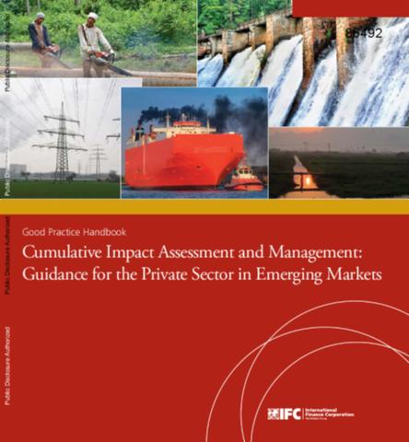
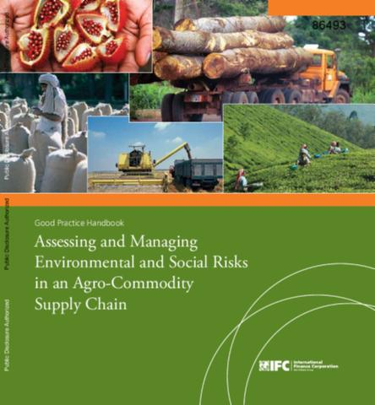
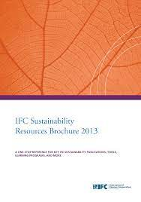
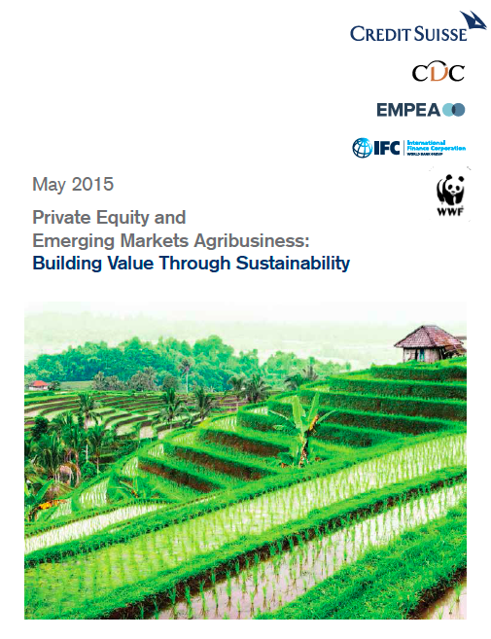
Tools and Resources
IFC Sustainability Framework (2012)
www.ifc.org/sustainability
WBG EHS Guidelines
www.ifc.org/ehsguidelines
ESG Publications:
For a full list, see: www.ifc.org/sustainabilitypublications
World Bank Group (WBG) Environmental, Health, and Safety (EHS) Guidelines
IFC has launched a three-year consultative process to revise the WBG EHS Guidelines. See www.ifc.org/EHSGuidelinesRevision
IFC Sustainability Framework - Effective January 1, 2012
Guidance Notes to IFC’s Performance Standards - Effective January 1, 2012
Good Practice Handbook: Cumulative Impact Assessment and Management: Guidance for the Private Sector in Emerging Markets
Good Practice Handbook: Assessing and Managing Environmental and Social Risks in an Agro-Commodity Supply Chain
IFC Sustainability Resources Brochure
Private Equity and Emerging Markets Agribusiness: Building Value Through Sustainability
www.ifc.org/disclosure

Slide 31
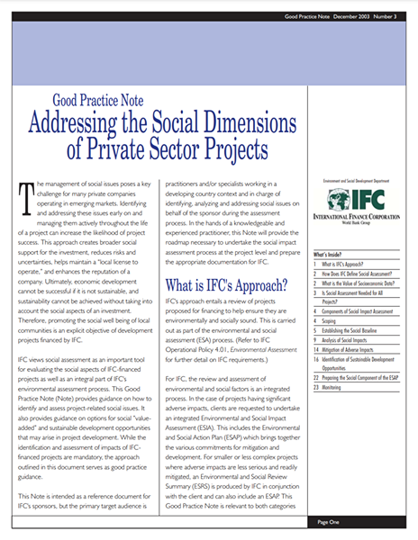
PS8 Publications
Guidance Notes
Performance Standard 8 Implementation Resources
Guidance Notes to IFC’s Performance Standards (January 1, 2012)
Lessons of Experience No. 3-Peru LNG: A focus on Continuous Improvement
Stakeholder Engagement: A Good Practice Handbook for Companies Doing Business in Emerging Markets (2007)
Good Practice Note: Addressing the Social Dimensions of Private Sector Projects (2003)
More resources are available at http://www.ifc.org/ps8
31

